Slide 1
STARS Training: Entering Team members
Ginny Paulson, SHIP TA Center, 7/18/2018
Notes:
Three job aids, a printable team member form, a user role at-a-glance reference in either color and in black & white, and today’s PPT are available for download until the official start time for today’s webinar. As a reminder, these materials are already posted on the STARS resources page. The address for that page is part of today’s training.

Slide 2
Agenda
Resources
Demo: Team Member Creation
STARS Basics
Q&A
Notes:
Hello everyone. Today’s primary training objective is to explain and support data entry for team member creation.

Slide 3
To View Full Screen
Click the arrows icon in the upper right area of your screen to enlarge the presentation.
If you wish to exit Full Screen mode, slide your mouse to the top of the screen to activate toolbar, then click “Return.”

Slide 4
STARS Resources, Training, and Support
Webinars
Manual
Job Aids
Notes:
The SHIP TA Center is responsible for hosting webinars, creating job aids, and housing STARS support materials online. ACL is updating the STARS manual based upon the former SHIP NPR manual. It will not be fully updated until later in 2018. Meanwhile, users should rely on the SHIP NPR manual and leaders at your SHIP for guidance about definitions, terms, and reportable efforts. Users should rely on STARS job aids and STARS training webinars for data entry instructions.

Slide 5
Job Aid Topics
STARS User Basics
One for STARS Submitter role
One for all other roles
Beneficiary Contact Form
Group Outreach and Education Form
Media Outreach and Education Form
Team Members
STARS Launch
FAQs (NEW!)
Search Tool
Reports
Notes:
Topics in green are available now. The Team Member job aid has been recently updated with a new appendix B – User Roles at-a-glance, and an updated Appendix A – STARS start dates. The Topics in orange will be published in conjunction with the webinars on that topic this summer. The Searches webinar is scheduled for August 8 at 3pmET. The reports aren’t issues in STARS yet, so webinars have not yet been scheduled. The job aids in bold align with today’s topic and will be made available for download at the end of today’s webinar, in addition to all of the other resources related to today’s topic.

Slide 6
Other Written Resources
User Roles at-a-glance (one page overview)
Beneficiary Contact Form definitions
Printable Beneficiary Contact Form
Group Outreach and Education definitions
Media Outreach and Education definitions
STARS Manual
Notes:
Topics in green are available now. Topics in orange are coming soon. The STARS Manual will be available later this summer. It will expand upon the job aids with increased definitions and guidance. Essentially, it will collect all STARS instructions and guidance in one document.

Slide 7
Webinar Series on Forms
Beneficiary Contact Form (monthly through October)
Group and Media Outreach Forms (monthly through October)
About this series
Announced to date: All through August
Intended for all users invited by their SHIP leader
Suggested audience: Current STARS users and SHIP representatives nearing their STARS start date
Entering Team Members (this is the last one)

Slide 8
Webinars and Other STARS Resources
Future Webinar Announcements
Provided to the SHIP director listserv and to director/administrator users at www.shiptacenter.org
Webinar PPTs, webinar recordings, job aids, forms, and other resources
Posted under “Need Help” on the STARS landing page
Collaborative Effort
End Users Satisfied

Slide 9
STARS Basics
Related to Team Member Creation
Notes:
Before we get into the demon

Slide 10
STARS User Essentials
1. Team Member Profile
2. Credentials (= Username + Password)
3. The STARS landing page link
Team member creation is the only kind of data entry allowed
in advance of the STARS start date for your group.
Notes:
After a new SHIP Team Member is created in STARS, that team member will be emailed their “credentials” (username and password). This information will arrive from STARS in separate auto-generated emails to the email address that was entered on the team member form. The sending address will be DoNotReplyACLSystems@bah.com. If you do not receive these emails, contact the Booz Allen STARS help desk. They provide all STARS username and password support. Team member creation is the only kind of data entry allowed in advance of the STARS start date for your group. Therefore, STARS users whose role is to simply enter beneficiary contacts and/or outreach efforts should be sent their credentials on or after their SHIP group start date.

Slide 11
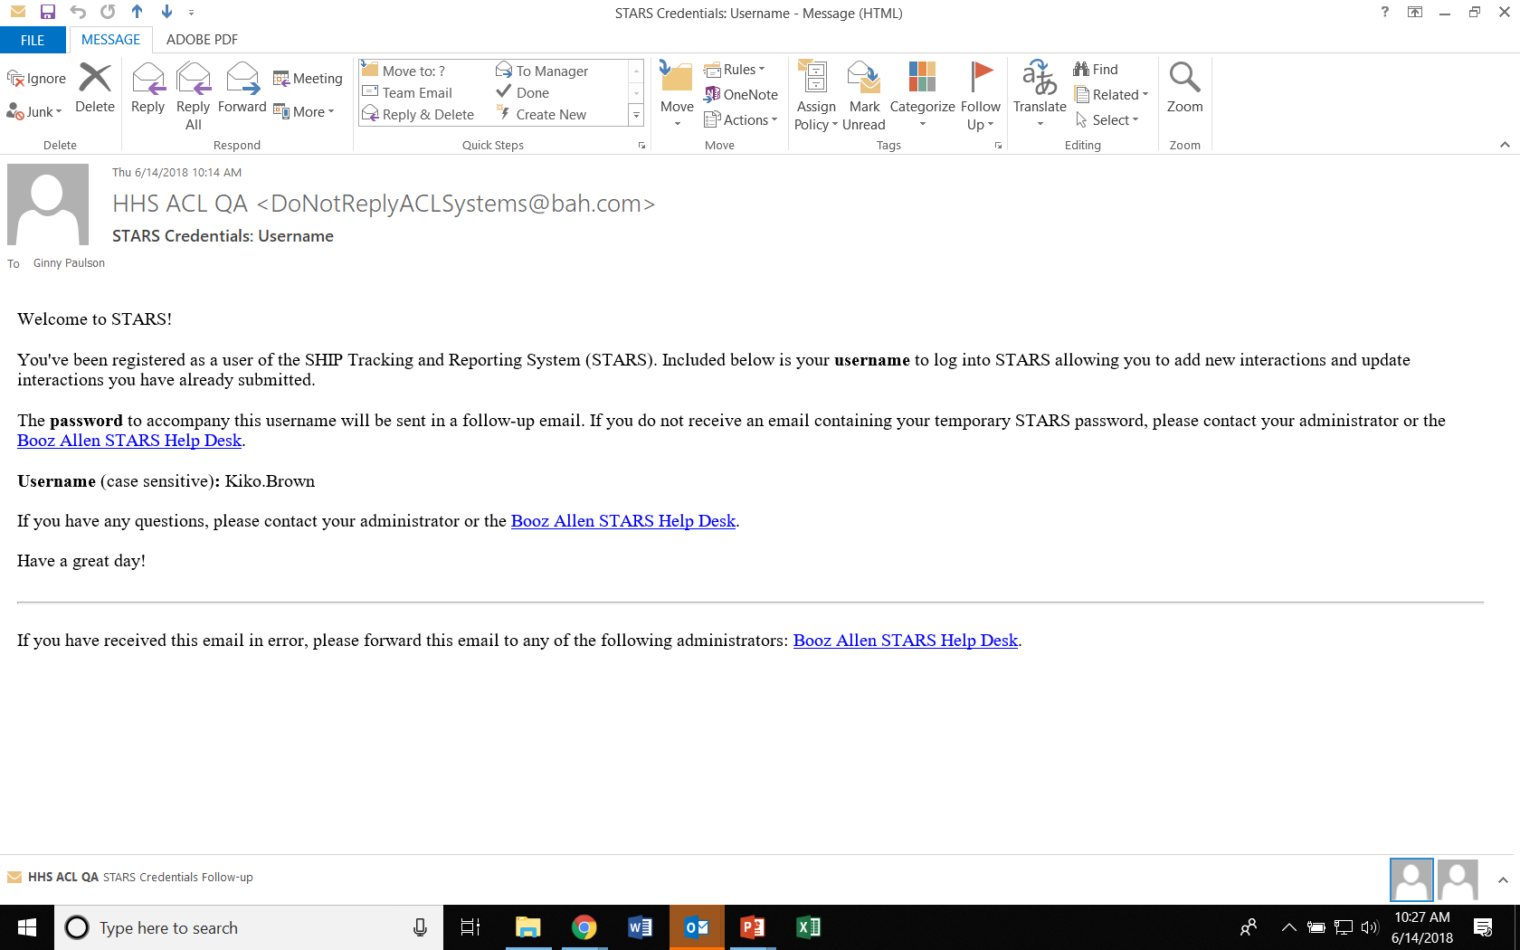
Credentials email

Slide 12
Password Email (possibility A)
Notes:
Most people are receiving this password email during the roll-out phase. That is because team member creation often occurs well in advance of sending credentials.

Slide 13
Password Email (possibility B)
Notes:
This is the password email people receive if they are sent credentials immediately upon being added to STARS. Notice that a password is provided (which you should change after logging in to something much easier to remember).

Slide 14
Your SHIP Group Start Date
Groups 1, 2, and 3 (Start Dates: 5/1, 6/1, and 7/1 respectively)
SHIP NPR: Direct entry
STARS: Direct entry
Groups 4 and 5 (Start Dates: 8/1 and 9/1 respectively)
SHIP NPR: Partial batch upload
STARS: Direct entry and/or API transfer
Group 6 (Start Date 10/1)
SHIP NPR: Full batch upload
STARS: Full API transfer
Notes:
It is important to know your SHIP Group “Start Date.” Start Date refers to the date SHIP efforts will be entered into STARS. ACL divided SHIPs into groups strategically, placing all of the full direct entry states into Groups 1, 2, and 3. Next, we will look at the list of SHIPs according to group, and I will explain the term “API”

Slide 15
Group One STARS Start Date: May 1
Group Two STARS Start Date: June 1
Group Three STARS Start Date: July 1
Group Four STARS Start Date: August 1
Group Five STARS Start Date: September 1
Group Six STARS Start Date: October 1
CT, DC, GU, NC, RI, UT
CO, IN, MA, MS, NE, NV, OK
IL, KS, MD, OR, PR, VA, VI, WA, WY
AK, AR, DE, FL, KY, ME, MO, ND, NJ, NM
AZ, HI, LA, MI, NY, OH, PA, SD, TN, TX?, VT, WI, WV
AL, CA, IA, ID, GA, MN, MT, NH, SC
Notes:
Here are the STARS Start Dates. ACL has divided SHIPs into 6 groups, each with their own start date. Some states are in the process of negotiating an earlier start date. Check with the leaders in your SHIP program if what you see on this slide differs from what you have been told by your SHIP program.

Slide 16
User Roles
Can Create Team Members
Other Roles
SHIP Director
SHIP Assistant Director
State Staff
Sub-State Manager
Site Manager
Sub-State Staff
Site Staff
Team Member
STARS Submitter
Notes:
Here are the role names available to SHIPs within STARS. The Team Member job aid and At-a-Glance User Roles Overview handout provide the information you need to decide what roles to assign your newly created team members.

Slide 17
Key Point in Team Member Creation
STARS User Limit:
STARS allows unlimited number of team members but
Only 450 concurrent users (those logged in at the same time nationally)
STARS Submitter Role:
Anyone using this role will NOT count against our concurrent user number
Use of this role is encouraged, unless it does not meet a user’s needs.
Notes:
From Rebecca’s 3/21/18 presentation: The system cannot have more than 450 users logged in at the same time. The 451st person will not be able to log in until someone else logs out. During OEP we often have over 500 users in the NPR at the same time. Any time you can use the STARS submitter role for a team member please do so since these users do not count against our license number.

Slide 18
STARS Submitter User Role
Role Name | Created by any of these STARS Team Members | Role Capabilities
STARS Submitter | SHIP Director SHIP Asst. Director State Staff Sub-State Mgr. Site Mgr. | Create forms for their efforts or efforts conducted by others at or below their level in the hierarchy View and update own forms and forms about their own efforts via their Tracking Inbox Unable to view/update data entered by others, about others Unable to view other team member profiles Unable to delete any type of data Unable to access to the search tool or reports
Notes:
Here is an excerpt from the updated job aid addressing this role.

Slide 19
Team Member vs. STARS Submitter
Team Member
STARS Submitter
Can be aligned at any level of the hierarchy
Do count toward the national STARS system concurrent user limit
Can view forms entered by others
Can use the search tool
Can be aligned at any level of the hierarchy
Don’t count toward the national STARS system concurrent user limit
Cannot view forms entered by others about others
Cannot use the search tool (must use Tracking Inbox instead)
Notes:
These roles are nearly identical. #1 is an important similarity between these two roles. #s 2 – 4 are important differences.

Slide 20
Demonstration
Notes:
Go to Job Aid and at-a-glance reference to review the User Roles, then go to STARS

Slide 21
FAQs
Notes:
Here are some frequently asked questions since the March STARS launch, mostly related to Team Member creation, but some are related to other STARS issues

Slide 22
Usernames and Passwords
Q: Are usernames email addresses?
A: No.
Q: Can an email address be used more than once in STARS?
A: Yes.
Q: How often will I need to re-set my STARS password?
A: Every 90 days
Notes:
NOTE: This STARS setting is temporarily inactivated during the STARS launch. The clock will not start ticking until 10/1/2018.

Slide 23
Changes in STARS
Q: Can I change team member user roles?
A: Yes, you can change a person’s STARS user role at any time.
Q:What if I need to change a team member’s organizational affiliation?
A: You should edit the team member profile to align that team member with a different organization within your state hierarchy.
Q: Can I change the organizational hierarchy in STARS?
A: Not independently. The hierarchy for each SHIP was set up in advance of the STARS launch. SHIP directors wanting to change their program hierarchy must contact ACL for permission, then work with Booz Allen Hamilton on the process. Changes vary in their level of complexity.
Notes:
About the first bullet: this is a big difference from SHIP NPR. About the second bullet – the team member’s past work stays aligned with the organization that team member was aligned with in the past. The team member’s work after the change will be aligned with the new organization.

Slide 24
Seeing Other Team Members
Q: I cannot see all of our team member forms. What do I do?
A: You can see team members you entered in your SHIP Team Member Tracking Inbox. Use the search menu to find and see all team members visible to you, including those entered by others.
Note: Users with the STARS Submitter or Team Member user roles cannot see the team member forms.
Notes:
Remember: You can only see team members at and below your level of the STARS hierarchy. For example, if you are at the State level, you can see all team members. If you are at the Sub-state level, you can see all team members at the Sub-state level and below. If you are at the Site level, you can only see team members at the Site level. Use the at-a-glance roles overview to assist you in understanding this.

Slide 25
Team Member Profiles
Q: Can a team member be aligned with more than one organization?
A: No. Each team member is aligned with only one organization in the STARS hierarchy
Q: Not all of my team members conduct their own data entry. Will they still need a team member profile?
A: Yes, every team member needs a profile, even if someone else will be entering their efforts into STARS. This is necessary for accurate reports.

Slide 26
1-800-Medicare Unique ID #
Q: Who can create and manage 1-800-Medicare Unique ID #s?
A: SHIP Directors and SHIP Assistant Directors
Q: Who can view a team member’s Unique ID?
A: Any role with the ability to view team members
Q: When do we use the Unique ID in STARS?
A: January 1, 2019 and beyond. Use the Unique IDs in SHIP NPR for the remainder of 2018
Q: How do I manage my Unique IDs in SHIP NPR after my STARS start date?
A: The SHIP NPR help desk at TFI will help you.

Slide 27
SHIP NPR to STARS Transition
Q: Can I enter efforts into STARS that occurred before my STARS start date? For example, if my STARS start date is July 1, can I enter efforts that occurred in June?
A: Yes, you can enter past efforts into STARS, as long as those efforts were not entered into NPR
Q: When will our data be migrated from SHIP NPR to STARS?
A: November 2018.
Note: SHIP NPR will be entirely turned off on 11/30/2018
Notes:
The data migration month has been moved from October 2018 to November 2018 to accommodate Group 6.

Slide 28
Individualized Technical Assistance
To learn about future STARS training, contact your SHIP program’s leaders.
For STARS technical assistance, such as with usernames and passwords or your organizational hierarchy, contact the STARS help desk at Booz Allen Hamilton:
boozallenstarshelpdesk@bah.com or 703-377-4424
For questions about job aids and other STARS support resources, contact the SHIP TA Center,
stars@shiptacenter.org or 877-839-2675.

Slide 29
Questions: Use Chat or Raise Hand
Find the “Participants” panel on the right.
Click the hand button to raise your hand. A hand will appear next to your name.
Tip: To lower your hand, click the hand button again.

Slide 30
Thank you for participating!
Today’s webinar materials are available for download within WebEx.
They are also posted at https://stars.entellitrak.com
The production of this webinar was supported by grant number 90SATC0001 from the Administration for Community Living (ACL).

