Slide 1
STARS Training: Group Outreach and Media Outreach Forms -Ginny Paulson, SHIP TA Center -Melissa Simpson, ACL
September 24, 2018

Slide 2
Agenda
Part One:
Sharing Data Overview
Outreach Forms Overview
STARS Forms Demonstration:
Group Outreach and Education (GOE) form
Media Outreach and Education (MOE) form
Part Two:
Data Transfer from NPR
STARS Access
STARS Resources, Training, and Support
Questions
Notes:
Hello everyone. Based upon feedback from previous webinars of this type, today’s webinar will be conducted in two parts. If you are primarily interested in watching the demonstration about entering data into STARS, that will be covered in Part One. You are welcome to leave for Part Two if you aren’t interested in further details. In the interest of time and considering the large group size, we will not be answering questions until the end. There is a STARS FAQs job aid that answers most frequently asked questions. Also, the job aid about this topic now has a new Appendix of definitions. Definitions of terms are also frequently asked questions.

Slide 3
Part One
Overview and Demonstration (approximately 45 minutes)

Slide 4
STARS
The following slides were created by
The Administration for Community Living (ACL)

Slide 5
STARS
SHIP Tracking And Reporting System (STARS)
National, web-based data system
Developed and owned by ACL OHIC
Contract with Booz Allen Hamilton
Sharing Data
MIPPA
SMP SIRS
Replaces SHIP NPR gradually between May and September 2018.
Six SHIP Groups and STARS start dates
Notes:
STARS start dates are the first day of the month.

Slide 6
Notes:
Timeline: Here are the STARS roll-out dates, by state. This is a stand-alone document on the STARS resources page. All SHIPs who enter data directly into STARS have reached their STARS Start date. September and October start dates pertain to SHIPs who use proprietary data systems, and that is not the scope for today’s webinar.

Slide 7
Sharing Data Overview
SMP, MIPPA, Duals Demonstration
Notes:
Each of the three main forms (Beneficiary Contact, Group Outreach, and Media) have the ability to share data with MIPPA, SMP, and/or CMS Duals Demonstration Grantees (CA, RI, VA, to name a few). Ensure the appropriate boxes are checked and entered in order to accurately report shared program activities

Slide 8
MIPPA Reporting
MIPPA is a required field
Select “Yes” radio button when outreach includes MIPPA topics
--See the job aids for more details on MIPPA-qualifying topics
Notes:
MIPPA is a required field. You might recall typing in MIPPA 1, 2, or 3 in SHIP NPR
Produced inconsistent results

Slide 9
SMP Reporting
STARS does not eliminate need for SIRS account
Data is shared one way only (STARS to SIRS) and only once
Forms updated in SIRS will not also be updated in STARS
In the event of an error, user must log in and update forms in both systems to make corrections/edits
“Send to SMP” (i.e. SIRS) should only be used for outreach and education that falls under both SHIP and SMP
Notes:
SMP stands for Senior Medicare Patrol. SIRS is the SMP data reporting system. SMP Information and Reporting System. Notice that the Send to SMP field defaults to No. You will need to click “Yes” if you are entering an SMP event.

Slide 10
“Send to SMP” Reporting, Continued…
SIRS eFile ID will auto-populate based on
1. Team member log in (change ID if entering another’s form)
2. SIRS eFile ID must be present on the STARS form for the data to transfer to SIRS
SIRS Reference Number auto-populates after form is saved
Notes:
SIRS eFile ID will auto-populate based on
1. Team member log in (can change if entering data forms for another team member)
2. SIRS eFile ID must be present on the STARS form for the data to transfer to SIRS
SIRS Reference Number auto-populates when form is saved

Slide 11
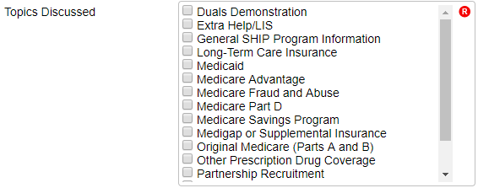
CMS Duals Demonstration Grants
Current grantees include CA, IL, MA, MI, NY, OH, RI, and SC
Topics Discussed
Select the new field “Duals Demonstration” topic when efforts include Medicare/Medicaid beneficiary (duals) work, and
Select any other topics that apply
Notes:
Those with the CMS Duals Demonstration Grants will be able to use STARS to report activities for these grants. CMS Duals Demonstration Grantees currently include the states listed on the slide: California, Illinois, Massachusetts, Michigan, New York, Ohio, Rhode Island, and South Carolina. SHIP Team members in these states conducting outreach and education work funded in part or whole should report it by selecting the new field “Duals Demonstration” in Topic Discussed section. In addition to selecting duals demonstration when appropriate, team members should indicate all other topics discussed or listed in the education and outreach activity. All additional details of the form may be analyzed by ACL and/or CMS in relation to the Dual Demonstration Grant

Slide 12
Outreach Forms Overview
Important Changes

Slide 13
Splitting the PAM Form
Split SHIP NPR Public And Media (PAM) form into two forms in STARS:
Group Outreach and Education
Media Outreach and Education
Simplified the group outreach elements that count towards current performance measures
Remainder of form mostly unchanged

Slide 14
Group Outreach & Education (GOE)
Type of Events
Interactive presentations
Booth/Exhibits
Enrollment Events
GOE data count towards SHIP Performance Measure #2 – Number of Attendees
Select date range for multiday events
NOTE: First three options on NPR PAM form
Notes:
Please note that the number of attendees at Group Outreach and Education Events count toward the national SHIP Performance Measures report.

Slide 15
Media Outreach & Education (MOE)
Type of Media:
The remaining 4 options from the PAM form are now on the MOE form, and the array of options has expanded
Wider range of Geographic Coverage selections
Can now select a date range for multiday events and campaigns, not just a single date
Zip Code County/Counties | Statewide Multi-state | Regional National
Notes:
Wider range of Geographic Coverage selections @ SHIPs request
Help track sitting at the state fair, statewide newspaper ads, regional tv psas, etc.

Slide 16
Demonstration

Slide 17
Session Conducted By and Additional Team Members
Main form allows one team member in Session Conducted By dropdown box
Click “Additional Team Member” tab after saving the main form to report team participants
Does not transfer to SIRS. Log
into SIRS to add team members.
Note: API feature does not currently support this feature. ACL is working with BAH on a possible enhancement to add this to API.
Notes:
Often need to add multiple team members time and efforts to the form, use Additional Team Member tab

Slide 18
Event Details and Time
Auto-populates based on team member selection in Session Conducted By dropdown after form is saved.
Time Spent message
Notes:
Partner Org Affiliation
Will auto-populate when save the form
Time
Use either or both
See message @ bottom of screen
Title of Interaction
Event name? something helps you track
Type of event
NEW dropdown ☺
Number of attendees
just enter in this field, don’t have a list for each event type as current form
Estimating = head counts, tick marks on paper at booth, sign in sheet, etc. vs. the number of folks reported by event organizers

Slide 19
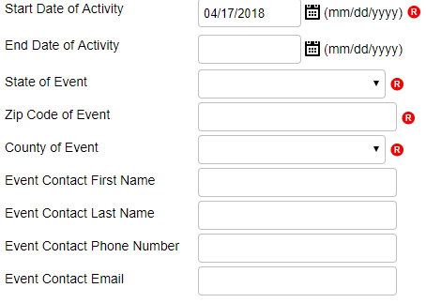
Event Details and Time Cont’d
NOTE: If entered, End Date must be a future date (e.g. 4/18/18 or later).
Notes:
NEW activity date range ☺
location
state= auto-populates based on user logged in, use dropdown to change
Zip = enter
County = auto-populates from zip code (2010 census list contact BAH help desk if zip not recognized)
Other event details optional from ACL,
state and local SHIP may require

Slide 20
Intended Audience
Split Intended Audience and Target Beneficiary Group in two boxes
Required field, must select one (can multi-select)
Notes:
Previously one long list, now two shorter lists
Alphabetical order – take few times to learn this list

Slide 21
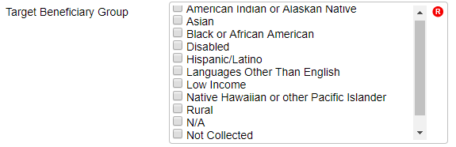
Target Beneficiary Group
Consolidated Target Beneficiary Group options to mirror other ACL system fields
Required field, must select one (can multi-select)
Notes:
Alphabetical order – take few times to learn this list. White/Caucasian is not a target beneficiary group, so select N/A.

Slide 22
Topics Discussed
Required field, must select one (can multi-select)
Notes:
Alphabetical order – take few times to learn this list

Slide 23
Part Two
NPR Data Transfer, STARS Access, STARS Resources and Support, Q&A

Slide 24
Have Questions about Part One?
Today’s webinar materials are posted at https://stars.entellitrak.com
Move your mouse around the bottom of your screen to activate chat. Click the blue chat bubble at the bottom of your screen.
Notes:
Due to the size of today’s audience, we are taking questions through chat.

Slide 25
Data Transfer from NPR

Slide 26
NPR Data Transfer into STARS
All direct entry states have now transitioned into STARS, and NPR is read-only
NPR data will be transferred to STARS in November
NPR goes away November 30th
Notes:
As a reminder, data transfer from proprietary systems is outside of the scope for today’s webinar.

Slide 27
Accessing NPR Data in STARS
NPR data will be moved to the state level in STARS
Only State-level users will be able to see and search this data
Individual forms can be reassigned to STARS team members and sites by state level staff, BAH, or ACL if needed
Counselor field on NPR transferred data will be blank in STARS
Counselor information will be saved in the 4th SUF in the transfer
Agency name will be saved to the 5th SUF

Slide 28
STARS Access

Slide 29
STARS User Essentials
1. Team Member Profile
2. Credentials (= Username + Password)
3. The STARS landing page link
Team member creation is the only kind of data entry allowed
in advance of the STARS start date for your group.
Notes:
After a new SHIP Team Member is created in STARS, that team member will be emailed their “credentials” (username and password). This information will arrive from STARS in separate auto-generated emails to the email address that was entered on the team member form. The sending address will be DoNotReplyACLSystems@bah.com. If you do not receive these emails, contact the Booz Allen STARS help desk. They provide all STARS username and password support. Team member creation is the only kind of data entry allowed in advance of the STARS start date for your group. Therefore, STARS users whose role is to simply enter beneficiary contacts and/or outreach efforts should be sent their credentials on or after their SHIP group start date.

Slide 30
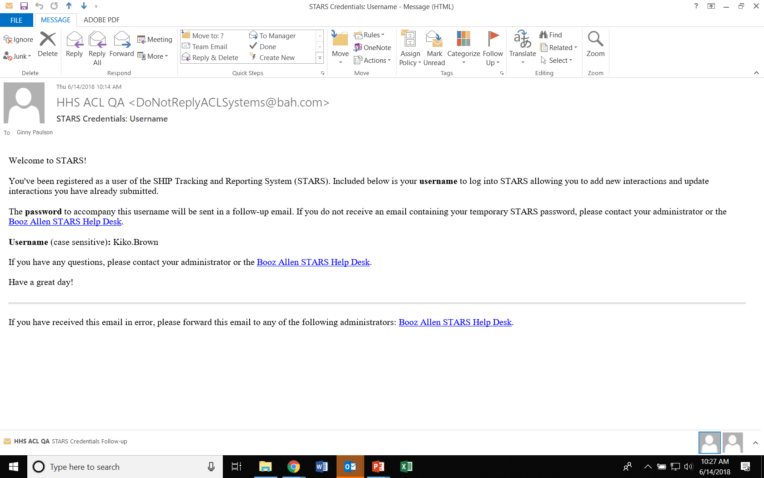
Credentials email

Slide 31
Password Email (possibility A)
Notes:
Most people are receiving this password email during the roll-out phase. That is because team member creation often occurs well in advance of sending credentials.

Slide 32
Password Email (possibility B)
Notes:
This is the password email people receive if they are sent credentials immediately upon being added to STARS. Notice that a password is provided (which you should change after logging in to something much easier to remember).

Slide 33
STARS Resources, Training, and Support
Webinars
Manual
Job Aids
Notes:
Ginny

Slide 34
STARS Landing Page
https://stars.acl.gov
Contains link to SHIP TA Center STARS training materials, including webinar PowerPoints, recordings, and job aids (coming later in 2018 - ACL’s STARS manual)
Contains link to Booz Allen STARS Help Desk
Notes:
Anyone with the link can visit the STARS landing page now. BUT, only users with credentials can successfully log in. Anyone who visits this page WILL be able to follow the link to the STARS resources, however. It is up to leaders in each SHIP program to distribute the STARS landing page link as appropriate. Note that the STARS landing page URL may change in the coming months. Stay tuned for announcements.

Slide 35
STARS Job Aids
STARS User Basics
One for STARS Submitter role
One for all other roles
Beneficiary Contact Form
Group Outreach and Education Form
Media Outreach and Education Form
Team Members
STARS Launch
FAQs
Searches
Reports (later in 2018)
Notes:
Topics in green are available now. They have been updated since their original release dates. The Reports job aid will be provided after the reports have been released into STARS.

Slide 36
Other Written Resources
PowerPoints for every STARS topic
User Roles at-a-glance (one page overview)
Beneficiary Contacts definitions
Group Outreach and Education definitions
Media Outreach and Education definitions
Printable versions of the STARS forms
STARS Security handout (i.e. slick sheet)
STARS Manual
Notes:
Topics in green are available now. By the way, we post the PowerPoint files from webinars – not PDFs – so that you can edit and use locally if desired. The STARS Manual will be available later this year. It will expand upon the job aids with increased definitions and guidance. Essentially, it will collect all STARS instructions and guidance in one document.

Slide 37
STARS Webinar Series
Group and Media Outreach Forms (monthly through October)
About this series
Intended for all users invited by a SHIP leader
STARS Searches and Reports (periodic, beginning in August 2018)
Beneficiary Contact Form (monthly through October)
Notes:
This STARS launch webinar series began in March 2018 and will continue through October 2018. We have concluded our series on entering team members, and we are launching a new topic on Searches.

Slide 38
Webinars and Other STARS Resources
Future Webinar Announcements
Provided to the SHIP director listserv and to director/administrator users at www.shiptacenter.org
Webinar PPTs, webinar recordings, job aids, forms, and other resources
Posted under “Need Help” on the STARS landing page
Collaborative Effort
End Users Satisfied
Notes:
We originally planned to resume our usual webinar announcement process after the STARS roll-out. Our usual process is to announce directly to registered users of our website based upon their role. We’ve decided that we need to retain our STARS webinar announcement process past October because of the 30+ SHIPs who use proprietary data systems. Their team members may not interact with STARS at all. Our webinar announcements would be likely to cause confusion in those 30+ programs. We will upgrade the password-protected area of our website to allow greater granularity in role permissions. The upgrade will allow you to tell us whether or not your users should received STARS training announcements. We expect the upgrade to be completed by August 2019.

Slide 39
What’s the difference?
* www.shiptacenter.org
* https://stars.acl.gov
Operated by the SHIP TA Center
Houses resources to help SHIPs train and manage their programs and educate the public
Supported by the SHIP TA Center
Operated by ACL and Booz Allen Hamilton
SHIP data reporting system
Contains links to all STARS training materials for all Users
Supported by ACL, Booz Allen Hamilton, and the SHIP TA Center
* Both require logging in, but they are separate systems and require separate accounts (think apples and oranges)
Notes:
Ginny: Here is a slide we have started using in our webinars to help people understand our Center’s website vs. the STARS website and our role with each.

Slide 40
Individualized Technical Assistance
For STARS technical assistance, contact the STARS help desk at Booz Allen Hamilton:
boozallenstarshelpdesk@bah.com or 703-377-4424
For questions about job aids and other STARS support resources, contact the SHIP TA Center,
stars@shiptacenter.org or 877-839-2675

Slide 41
Have Questions?
Today’s webinar materials are available for download within WebEx.
They are also posted at https://stars.entellitrak.com
Move your mouse around the bottom of your screen to activate chat. Click the blue chat bubble at the bottom of your screen.
Notes:
Due to the size of today’s audience, we are taking questions through chat.

Slide 42
Thank you for participating!
Today’s webinar materials are available for download within WebEx.
They are also posted at https://stars.entellitrak.com
The production of this webinar was supported by grant number 90SATC0001 from the Administration for Community Living (ACL).

