Slide 1
API & STARS

Slide 2
Agenda
API Updates
Q&A with ACL & Booz Allen

Slide 3
Options for States/Sites that Used Batch Upload in NPR
Batch Upload in NPR
Transfer Data through API
Direct Entry into STARS

Slide 4
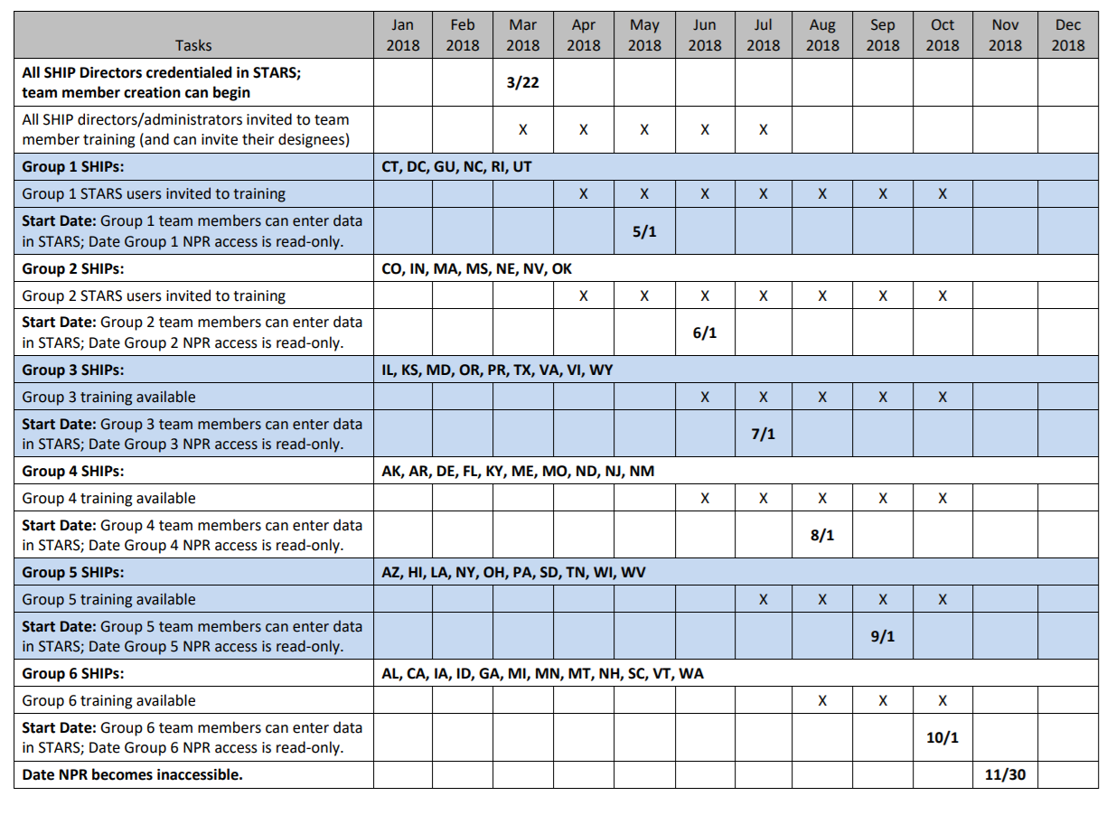
Timing of the Transition to STARS

Slide 5
What Can & Cannot Be Sent by API to STARS
Can be Sent via API:
Beneficiary Contact form
Group Outreach & Education form
Media Outreach & Education form
Send to SMP functionality
Cannot be Sent via API:
Additional Sessions
Additional Presenters
Team Member form
Update forms
Delete forms

Slide 6
Recent Updates to API Specs
Special Use Fields 1 & 2 are now PDP/MA-PD Cost Fields
BCF: “Topics Discussed” Guidance Added
BCF: Duals Demonstration Guidance Added

Slide 7
Resources Available for API SHIPs
API Specifications (.yaml file)
List of STARS fields and type of fields (Excel)
Database IDs for Prod & QA Environment (Excel)

Slide 8
Other Relevant Resources
NPR to STARS Mapping
STARS to SIRS Mapping (Co-located SHIPs & SMPs)
Hard copy versions of all forms (with dropdown options/all fields listed)

Slide 9
Where to Find API Resources
stars.entellitrak.com

Slide 10
Where to Find API Resources

Slide 11
FAQs
Errors
The full record will get rejected if an improper value is submitted.
Records are internally validated by STARS and improper values will be rejected with a 400 error.
API functionality will embellish error codes with additional information indicating why the record cannot be saved and in which field the error is located.
Scheduled maintenance notifications will be released through Booz Allen and ACL prior to down times.
Records sent by API are immediately processed and accessible through the Case Number in the response.
Last batch upload into NPR: September data by end of October; all October data should be sent by API.

Slide 12
Q&A

Slide 13
Contact Information
Technical questions & troubleshooting: BoozAllenSTARSHelpDesk@bah.com
STARS training or resources: stars@shiptacenter.org

